Slide 1

XAI for Transparency in Cyber Defense
Enhancing trust in AI-powered threat detection is essential for modern cybersecurity.
Devika & Harsh | 2025
Notes:
Cybersecurity is a critical challenge in the digital age, as threats are constantly evolving and becoming more sophisticated. AI and machine learning are playing an increasingly important role in threat detection and response, but there can be issues with trust and transparency. Explainable AI, or XAI, is a way to make AI systems more interpretable and accountable, enhancing trust in their decisions and actions. This presentation will explore how XAI can be leveraged to improve transparency and trust in AI-powered cyber defense. I'll discuss the key principles of XAI and how they can be applied to cybersecurity use cases. We'll also look at some real-world examples of XAI being used to enhance trust in AI-based threat detection and response.

Slide 2

Introduction to Explainable AI
What is XAI?
Importance in Cybersecurity
Explainable AI makes AI decisions transparent and understandable to humans.
Security teams need to trust AI decisions for accurate threat detection.
Limitation of Black-Box Models
They lack explanation, causing gaps in trust and accountability.
Notes:
Explainable AI, or XAI, refers to the ability to make AI decisions transparent and understandable to humans. This is crucial in cybersecurity, where security teams need to fully trust the decisions made by AI-powered threat detection systems. Traditional "black-box" AI models lack the ability to explain their reasoning, creating gaps in trust and accountability. XAI helps bridge this gap by providing visibility into how AI models arrive at their conclusions, enabling security teams to validate and trust the AI's decisions.

Slide 3

The Problem with AI in Cyber Defense
Rising Threats
AI Models as Black Boxes
Cyber attacks are more frequent and sophisticated.
They make decisions without human-understandable reasons.
Lack of Trust
Security experts struggle to justify AI alerts.
Notes:
• Cyber attacks are becoming more frequent and sophisticated, posing a serious threat to organizations. • Many AI models used in cyber defense are like "black boxes" - they make decisions without providing clear, human-understandable reasons. • This lack of transparency makes it difficult for security experts to trust and justify the alerts and recommendations generated by these AI systems. • Without being able to understand the reasoning behind an AI's actions, it's challenging to have confidence in the model's ability to effectively defend against evolving cyber threats.

Slide 4



XAI: The Solution for Transparency
Trust Building
2
Clear explanations increase confidence in AI systems.
Interpretability
1
Humans understand why models flag threats.
Model Refinement
Explanation helps reduce false positives and improve accuracy.
3
Notes:
The title of this slide is "XAI: The Solution for Transparency" The key points are: Interpretability: Humans can understand why the AI model flags certain threats, making the system more transparent Trust Building: Providing clear explanations increases confidence and trust in the AI system Model Refinement: Explanations help identify areas for improvement, allowing the model to be refined and made more accurate over time The goal is to highlight how explainable AI (XAI) techniques can address the need for transparency and trust in AI systems, while also enabling continuous improvement. I'll emphasize how XAI is crucial for mission-critical applications where understanding the model's reasoning is essential. I'll give a high-level overview of the key benefits, and then dive deeper into each one in the following slides.

Slide 5

Code & Tools Overview
Dataset
Network traffic data with bytes, duration, protocol, and flag
Preprocessing
Categorical encoding and feature scaling with StandardScaler
Model
RandomForestClassifier with balanced class weighting
Evaluation
Accuracy, classification reports, feature importance visualization
Notes:
This slide provides an overview of the key components used in our cybersecurity AI project. The dataset we're working with includes network traffic data with features like bytes, duration, protocol, and flags. For preprocessing, we used categorical encoding and feature scaling with StandardScaler to prepare the data. Our model is a RandomForestClassifier, with balanced class weighting to handle any imbalance in the target classes. To evaluate the model, we'll look at accuracy, classification reports, and feature importance visualizations. These tools and techniques form the core of our approach to building an effective cybersecurity AI system.

Slide 6
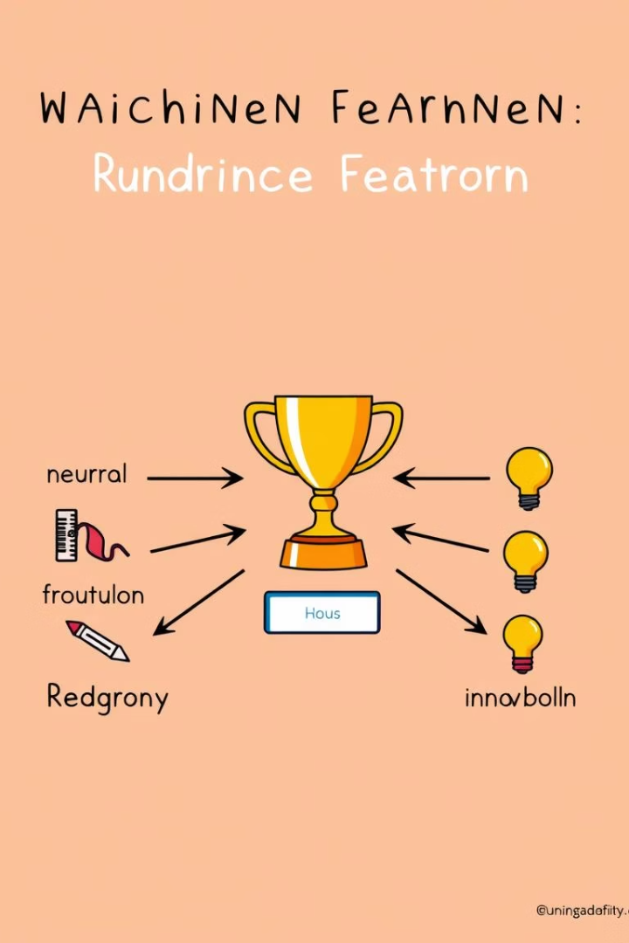
Feature Importance in XAI
Key Features
Explainability
'src_bytes' and 'duration' are most influential in model decisions.
Shows which features lead to malicious classifications.
Justification
Helps security teams understand and trust AI alerts.
Notes:
The key features that are most influential in the model's decisions are 'src_bytes' and 'duration'. This feature importance analysis provides explainability, showing which specific features lead to malicious classifications. This justification helps security teams understand and trust the AI alerts, giving them confidence in the model's decisions. The visual of the feature importance bar chart makes it easy to quickly see the relative impact of each feature. Understanding the key drivers behind the model's outputs is critical for deploying AI systems in high-stakes security applications.

Slide 7
XAI Real-World Use Cases
Intrusion Detection
Phishing Detection
Malware Classification
Alerts explained by traffic volume and session duration.
Highlights risky email attributes for clearer threat context.
Behavioral features explain why files are flagged as malicious.
Notes:
This slide introduces three real-world use cases for Explainable AI (XAI) In the first use case, XAI is used to explain intrusion detection alerts based on traffic volume and session duration The second use case shows how XAI highlights risky attributes in emails to provide clearer context for phishing detection The third use case demonstrates how XAI can explain which behavioral features led to a file being classified as malicious for malware detection These examples illustrate how XAI can provide valuable insights to security analysts and users, going beyond just the model's predictions XAI helps increase trust and transparency in these critical security applications

Slide 8
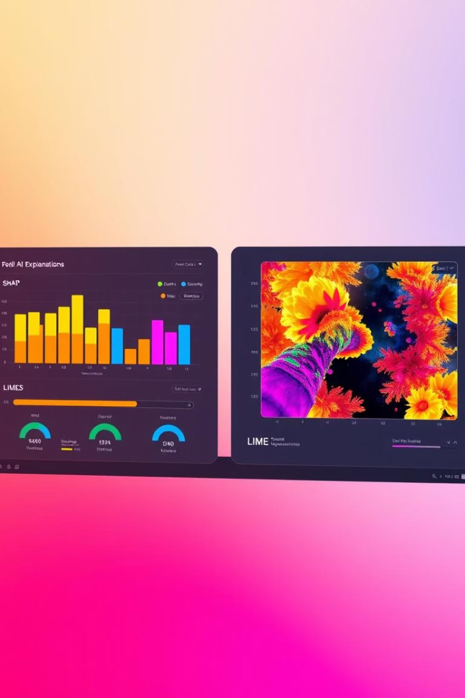
Future Enhancements in XAI
SHAP & LIME
Enhanced localized interpretability for individual decisions.
Real-time Dashboards
Dynamic explanations for analysts during live incidents.
Context Integration
Embedding threat intelligence for richer AI insights.
Ethical AI
Ensuring responsible adoption and fairness in cybersecurity.
Notes:
The future of explainable AI (XAI) in cybersecurity holds exciting advancements. SHAP and LIME will provide enhanced localized interpretability, allowing analysts to better understand individual AI decisions. Real-time dashboards will deliver dynamic explanations to analysts during live security incidents, enabling faster and more informed responses. Integrating contextual threat intelligence will enrich the AI's insights, providing richer and more actionable recommendations. Ethical AI principles will be embedded to ensure the responsible and fair adoption of these advanced analytics in cybersecurity.

Slide 9


Demo Example: AI Explanation
Input Values
Model Output
src_bytes=5000, dst_bytes=20000, duration=1200, flag=RSTO, protocol=TCP
Connection classified as malicious.
Explanation
Demo video:
High bytes and long duration suggest possible data exfiltration.
Notes:
This slide provides an example of an AI-powered cyber attack detection system. It shows the input values that were fed into the model, including source and destination bytes, duration, flag, and protocol. The model output indicates that the connection was classified as malicious. The explanation provided suggests that the high bytes and long duration are indicators of potential data exfiltration, which is a common tactic used in cyber attacks. This example helps illustrate how AI can be used to detect and explain potential cyber threats in real-time. The visual representation of the network traffic and flagged connection makes it easy to understand the context of the detection.

Slide 10

Conclusion & Takeaways
Explainability is Essential
XAI Improves Security
It bridges AI capabilities and human trust in cyber defense.
Transparent models boost detection accuracy and accountability.
Ready for the Future
Adopt XAI to meet evolving cyber threats with confidence.
Notes:
• Explainability is essential for bridging the gap between AI capabilities and human trust in cyber defense. When AI models can explain their reasoning, security professionals are more likely to trust and act on their insights. • Transparent, explainable AI models boost detection accuracy and accountability in cybersecurity. Stakeholders can better understand how decisions are made, improving overall security. • As cyber threats continue to evolve, adopting explainable AI will be crucial to meet these challenges with confidence. XAI provides the visibility and trust needed to leverage AI effectively in the future of cybersecurity.

